Slide 1
Some background information
on X-ray experiment, SS-02
Demonstrators: Giri Mani
Jan Knapp
Figures from Elements of X-Ray Diffraction: B.D. Cullity and S.R. Stock, Pearson, Third Edition (2014).

Slide 2
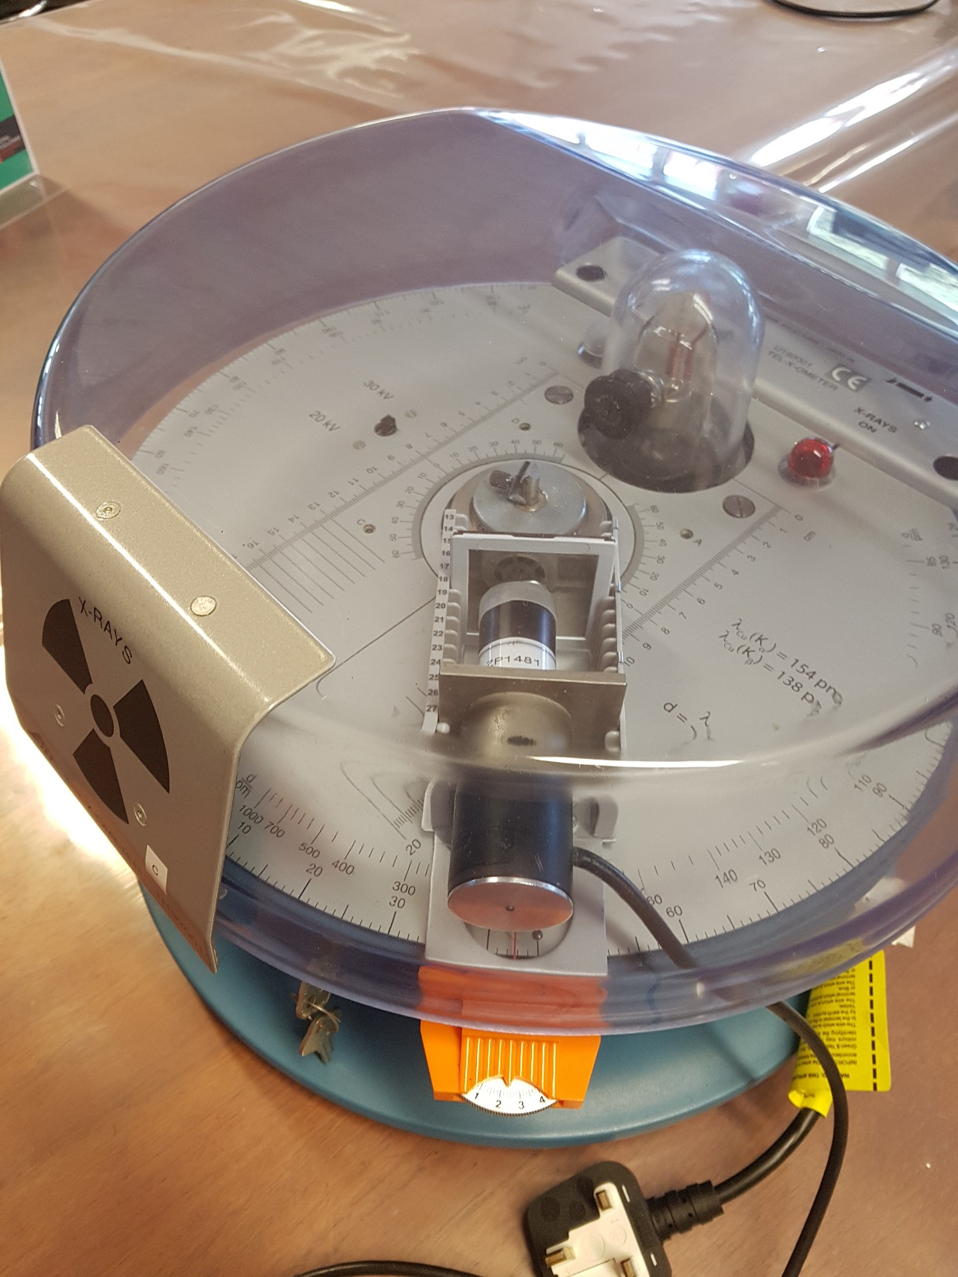
B22 – 1st Year Lab

Slide 9
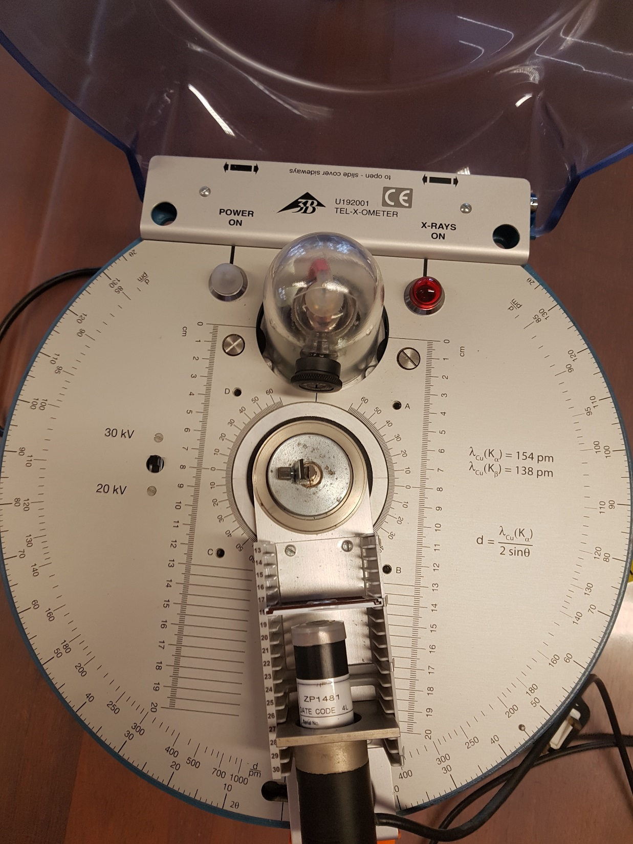

Slide 10
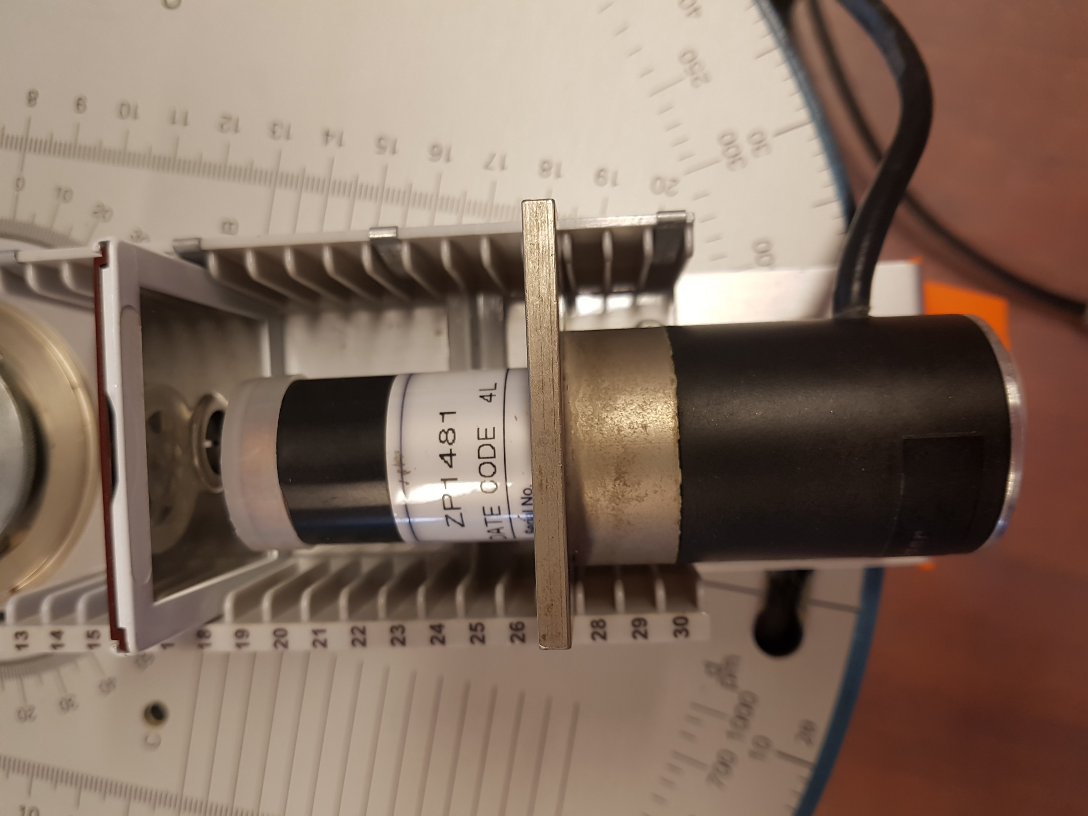

Slide 11
Note X-ray source: Mo

Slide 12
